Slide 1
SUPER LINKS
FIFO property
MDP: LB generation
MDP: Reversed link travel time
MDP: TDSP, FSPT, BSPT, ABSPT

Slide 2
Dynamic Discretization Discovery Algorithms for
Time-Dependent Shortest Path Problems
Problem statement
Minimum duration time-dependent shortest path problem (MDP for short)
Minimum travel time time-dependent shortest path problem (MTTP for short)
In MDP, the problem is to find a path such that the difference between the departure time at the source and the arrival time at the sink is as small as possible.
In MTTP, the problem is to find a path such that the total travel time from the source to the sink is as small as possible.

Slide 3
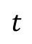
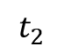
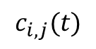
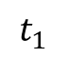
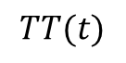
FIFO property
Arc time-dependent travel time is represented by a piecewise linear function:
$$c_{i,j}(t)$$
The FIFO property is equivalent to property in which the slopes of all linear pieces are at least -1.
Why? Let us find the reason.
It should be noted that if the slopes of linear pieces are greater than or equal to zero, FIFO property can be verified easily.
Let us discuss about cases in which the slope is less than zero.
$$TT(t)$$
Travel time function with only one linear piece. The slope is -1.
3
B
A
Suppose there are two commuters and entering time instants are $t_{1}$ and $t_{2}$.
2
E
H
D
The FIFO property requires that the arrival time of orange commuter should not be earlier than that of red commuter.
1
C
F
1
2
3
$$t$$
Arrival time of red commuter = AB+AC = AB+AH+HC
$$t_{1}$$
$$t_{2}$$
Arrival time of orange commuter = DE+DF = DH+HE+DF
DF=HC, AB=HE
->
We need to compare AH and DH.
The relationship between AH and DH depends on the slope of green line segment.
In this example, the slope is -1, indicating AH=DH. Therefore, the arrival time of two commuters are the same.

Slide 4
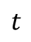
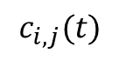
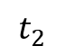
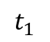
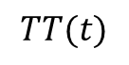
FIFO property
Arc time-dependent travel time is represented by a piecewise linear function:
$$c_{i,j}(t)$$
This function should satisfy FIFO property. It is equivalent to having the slopes of the linear pieces be at least -1.
Why? Let us find the reason.
It can be easily generalized into cases with multiple linear pieces.
$$TT(t)$$
Segment 1
Segment 2
Similarly, we need to determine whether AG is less than GB, which
depends on the slope of line segment of AB.
C
A
B
D
G
It is obvious that the slope of AB is in between
that of segment 1 and segment 2.
E
F
$$t$$
$$t_{1}$$
$$t_{2}$$
We already required the slope of ANY segment be as least -1, leading to the slope of AB is also be at least -1, which ensures that AG is less than GB. Thus, FIFO can be satisfied.

Slide 5
Problem description
The FIFO property of arc travel time function tells us:
(1) For MDP, there is no benefit in waiting at intermediate nodes and optimal solution is always waiting-free.
(2) For MATP (Minimum Arrival Time Problem), we must depart from the origin node at the beginning of time horizon and do not wait at any intermediate node.

Slide 6
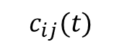
MDP
The DDD algorithm for MDP
Associate a travel time function with each link.
Tail node
(from_node)
Head node
(to_node)
$$c_{ij}(t)$$
Attributes of this function:
Univariate function
Continuous function
Input variable: departure time instant at the tail node.
Output variable: travel time for traversing this link.
Linear piecewise function, all the breakpoints are at integer points.
Satisfy FIFO property.
Mathematically, $c_{ij}\left(t\right)+t$ is a monotone increasing function with respect to $t$
We use interpolation to compute travel time departing at any time $t∈(−∞,T]$.
There exists a reversed travel time function associated with this $c_{ij}(t)$, called $c_{ij}^{rev}(t)$.
It is used for computing time-dependent shortest path terminating at a given destination node.

Slide 7
MDP
The DDD algorithm for MDP
Recall the preceding problem statement, the MDP tries to minimize the total duration. Therefore, waiting time is counted into the duration once the vehicle departs from its origin.
Since we assume that the travel time function strictly satisfies FIFO property, it does not bring any benefit if we wait at any intermediate node. Consequently, the vehicle will not take any waiting action until reaches its destination. The duration of the path is the summation of travel times of all physical links traversed by this path.
Dean, B. C. (2004). Shortest paths in FIFO time-dependent networks: Theory and algorithms. Rapport technique, Massachusetts Institute of Technology, 13.

Slide 8
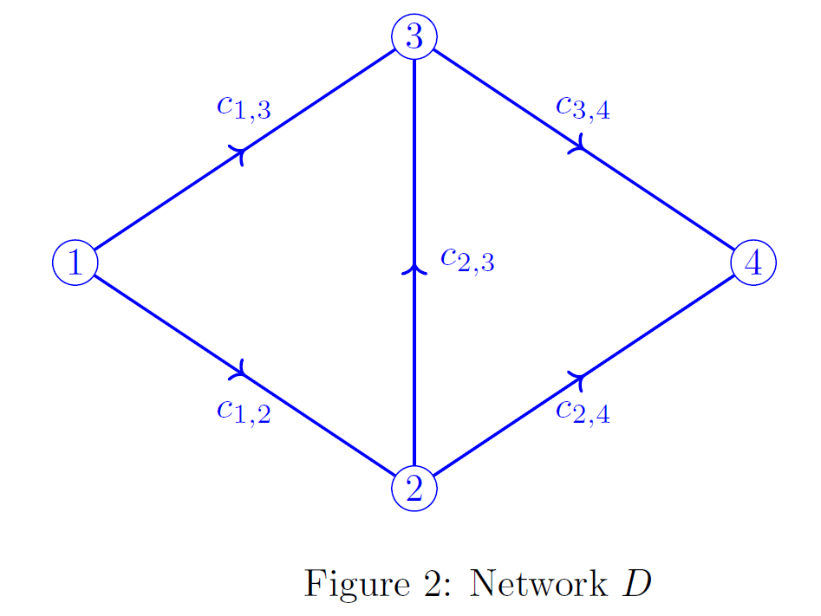
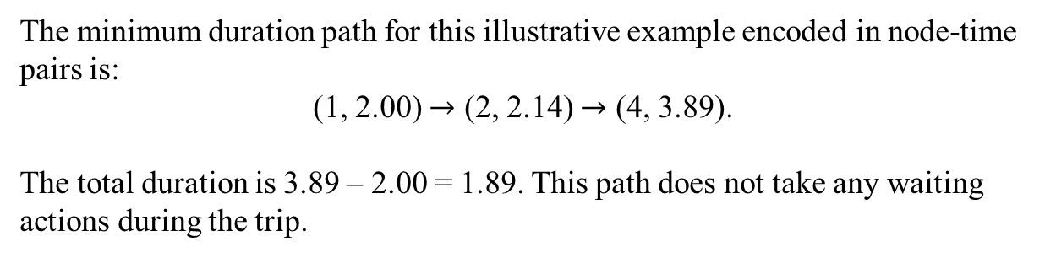
MDP
The DDD algorithm for MDP
Back to our example, suppose that a vehicle tries to find a minimum duration path from the node 1 to the node 4.
The minimum duration path for this illustrative example encoded in node-time pairs is:
(1, 2.00) $→$ (2, 2.14) $→$ (4, 3.89).
The total duration is 3.89 – 2.00 = 1.89. This path does not take any waiting actions during the trip.

Slide 9
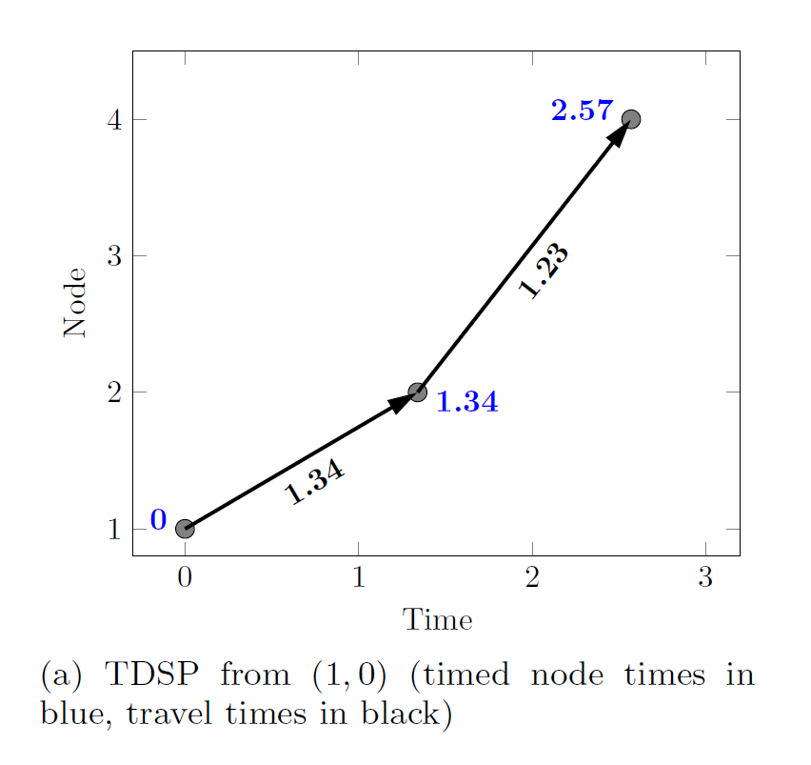
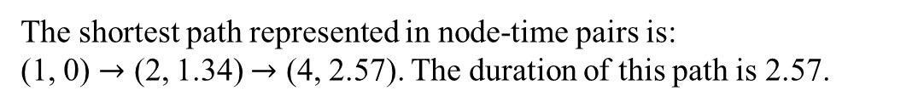
MDP
The DDD algorithm for MDP
The DDD algorithm firstly computes the forward time-dependent shortest path departing from node 1 to the node 4 at time 0.
In other words, we solve a one-to-one shortest path problem.
The path finding result is shown in the following figure.
The shortest path represented in node-time pairs is:
(1, 0) $→$ (2, 1.34) $→$ (4, 2.57). The duration of this path is 2.57.
This time-space path indicates the earliest arrival time at node 4 is 2.57.

Slide 10
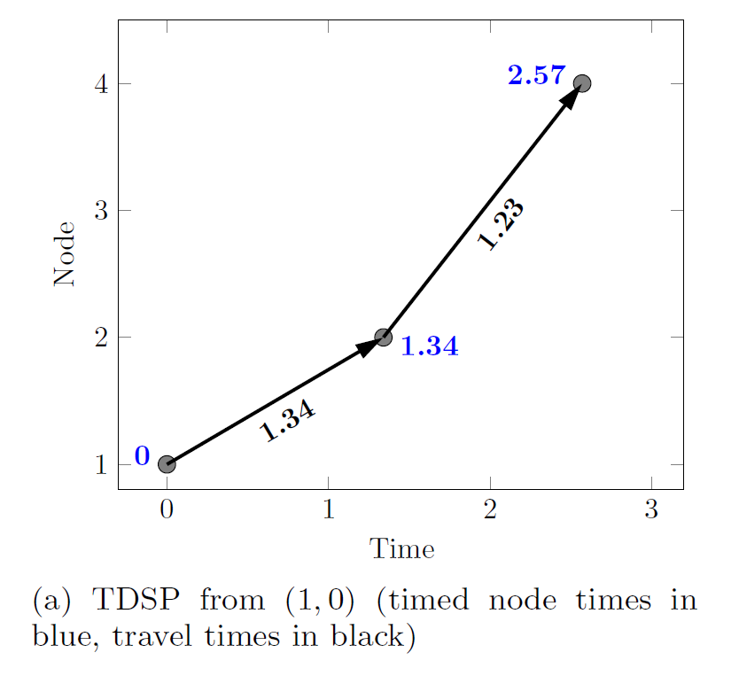
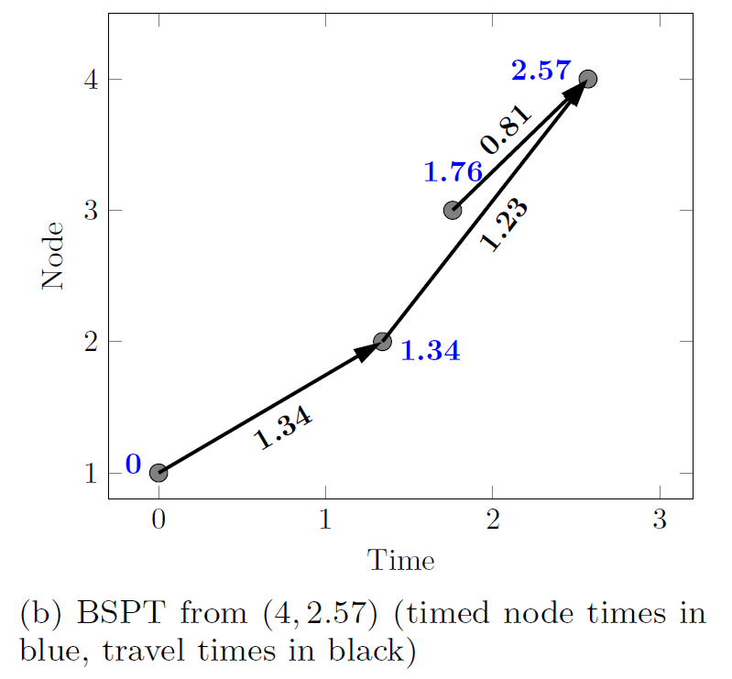
MDP
The DDD algorithm for MDP
Given that the earliest arrival time at node 4 is 2.57, we can compute the Backwards Shortest Path Tree (BSPT) whose root node is (4, 2.57).
To obtain the BSPT, we need the reversed arc travel time function $c_{ij}^{rev}(t)$.
Note that the time-space trajectory (0, 0) $→$ (2, 1.34) $→$ (4, 2.57) in figure (a) remains unchanged in figure (b).
All the physical nodes are involved in the BSPT, while node 3 is not involved in the time-space path of figure (a).

Slide 11
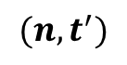
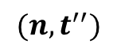
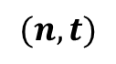
MDP
The DDD algorithm for MDP
The motivation for computing BSPT:
Why we need to compute BSPTs?
What is the role of BSPTs in the DDD algorithm for solving the MDP?
Let us analyze the key properties and benefits of the BSPTs.
4
$$(n,t)$$
$$(n,t^{′})$$
$$(n,t^{′′})$$
3
Node
2
1
Time

Slide 12
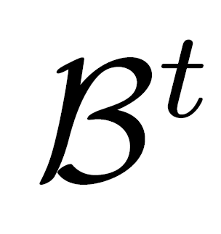
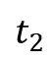
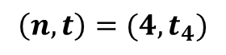
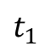
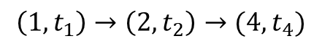
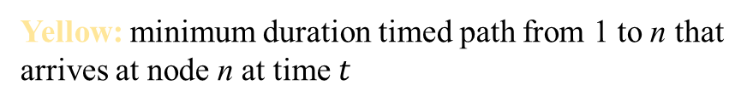
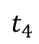
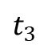
MDP
The DDD algorithm for MDP
4
$$\left(n,t\right)=(4,t_{4})$$
Green:
Yellow: minimum duration timed path from 1 to n that arrives at node n at time $t$
3
Node
2
Representative timed node sequence in
is:
$$\left(1,t_{1}\right)→\left(2,t_{2}\right)→(4,t_{4})$$
1
$$t_{1}$$
$$t_{3}$$
$$t_{2}$$
$$t_{4}$$
Time

Slide 13
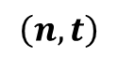
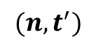
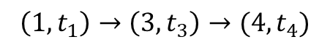
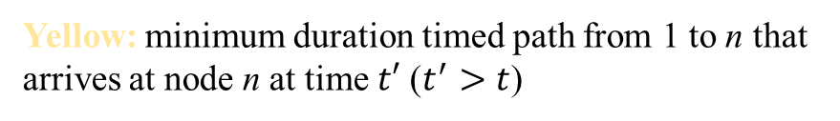
MDP
The DDD algorithm for MDP
4
$$\left(n,t\right)$$
$$(n,t^{′})$$
Green:
Yellow: minimum duration timed path from 1 to n that arrives at node n at time $t′$ ($t^{′}>t$)
3
Node
2
Representative timed node sequence in
is:
$$\left(1,t_{1}\right)→\left(3,t_{3}\right)→(4,t_{4})$$
1
$$t_{1}$$
$$t_{3}$$
$$t_{2}$$
$$t_{4}$$
Time

Slide 14
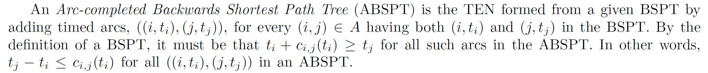
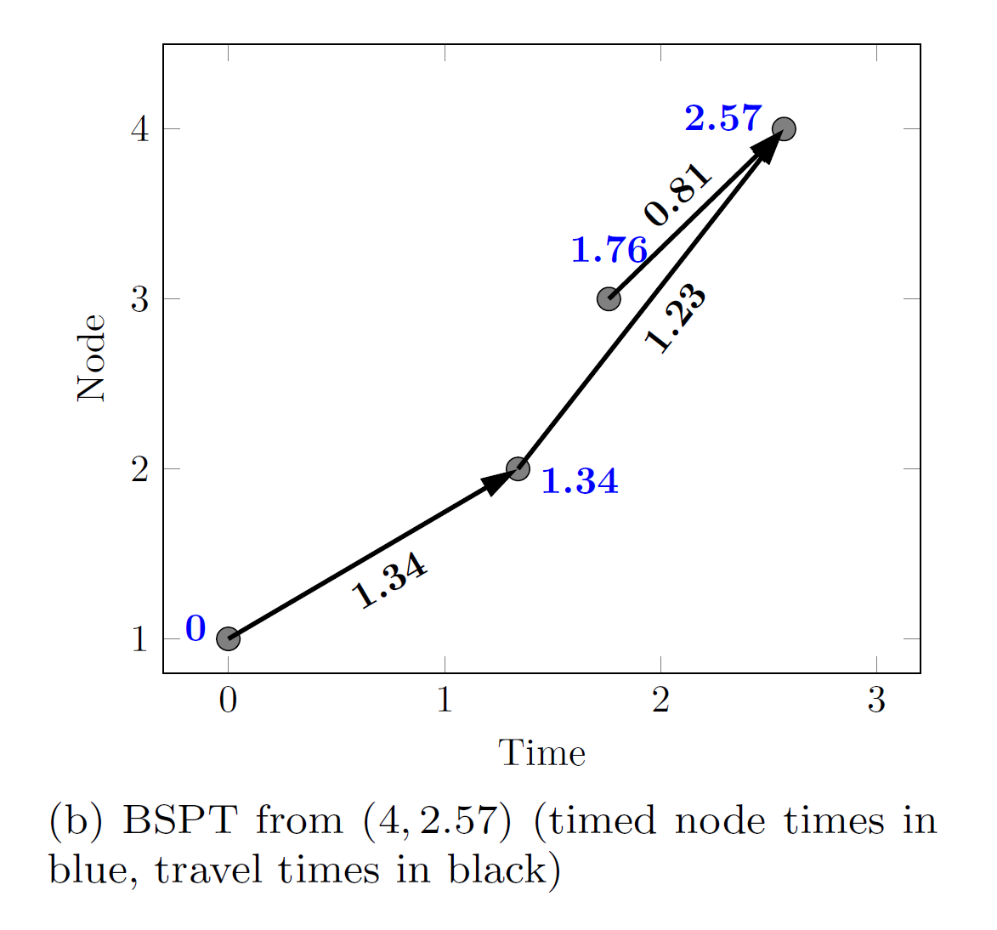
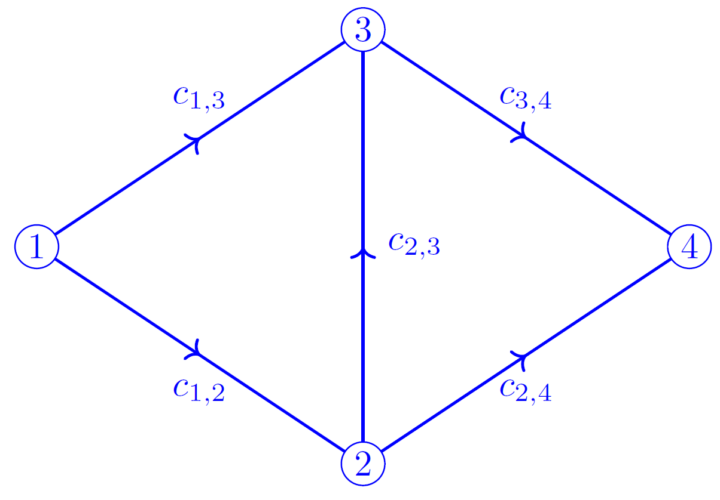
MDP
The DDD algorithm for MDP
1.76
0.42

Slide 15
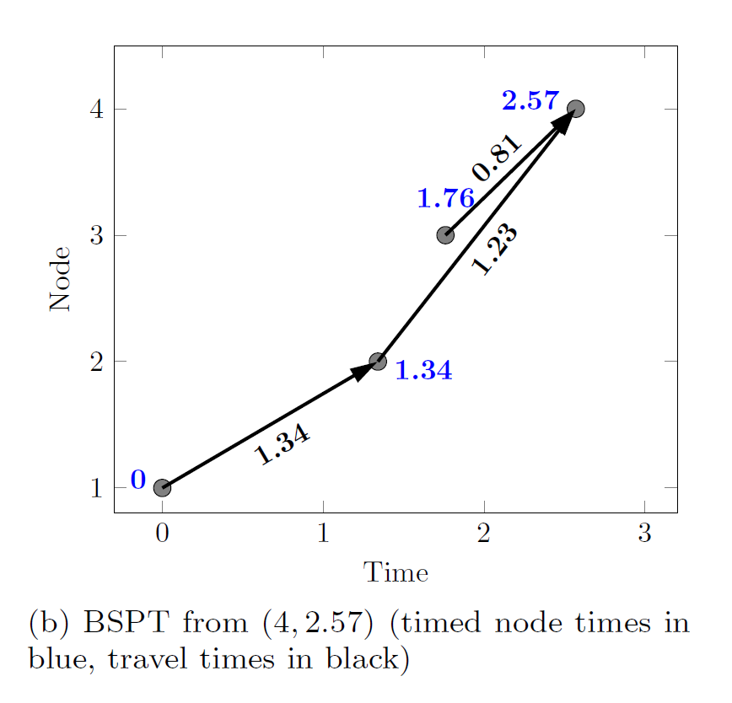
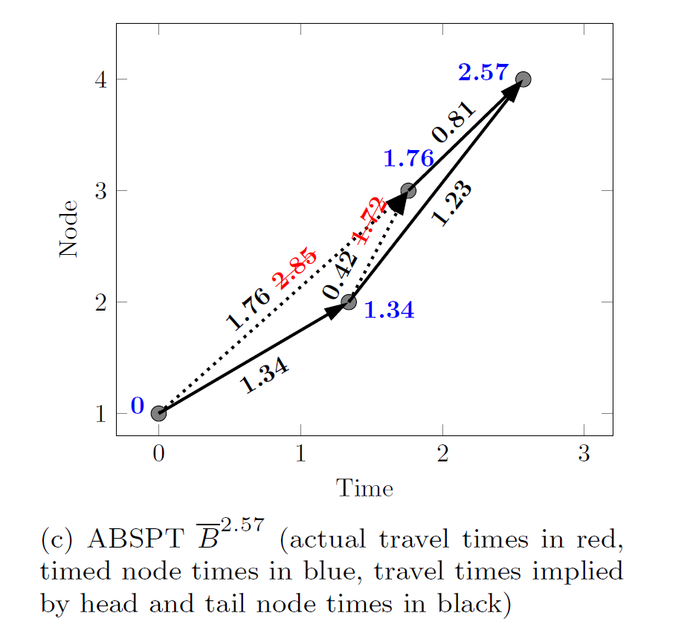
MDP
The DDD algorithm for MDP

Slide 16
MDP
The DDD algorithm for MDP
The procedure and the basic idea of this DDD algorithm for the MDP:
Our algorithm works by maintaining a list of ABSPTs, ordered by their time at the end node. The list is initialized with two ABSPTs: the ABSPT for the earliest time that the end node can be reached and the ABSPT with end time given by the end of the time horizon. These two times define the time interval of interest : all feasible timed paths must arrival at the end node within this interval. Additional ABSPTs are generated dynamically, subdividing this interval.
Based on the basic idea, we need to consider the implementation details of this DDD algorithm.
How to dynamically generate new ABSPT?
How to determine the lower bound on the minimum duration?
Note that the upper bound can be easily obtained from the feasible path we have already got.

Slide 17
MDP
The DDD algorithm for MDP
Consider the derivation of the lower bound on the minimum duration...
Recalling from the preceding analysis, the waiting action is not taken during the whole trip.
As a result, the duration of a path is composed of travel time of all involved links.
If we can derive the lower bound on every arc’s travel time function via some greedy mechanism, then the lower bound can be obtained easily.

Slide 18
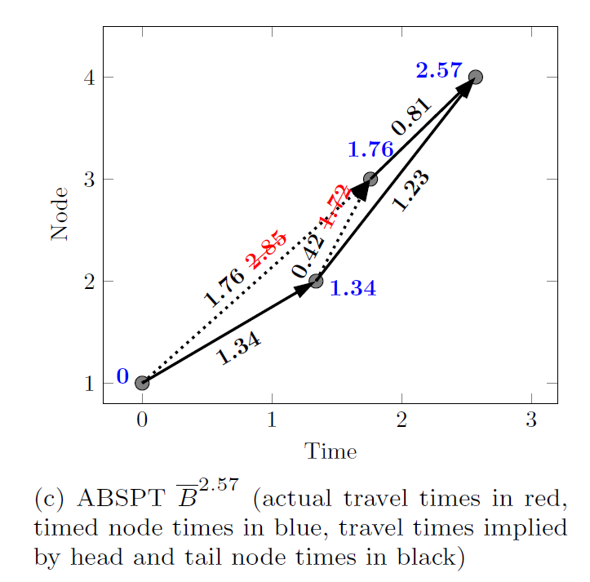
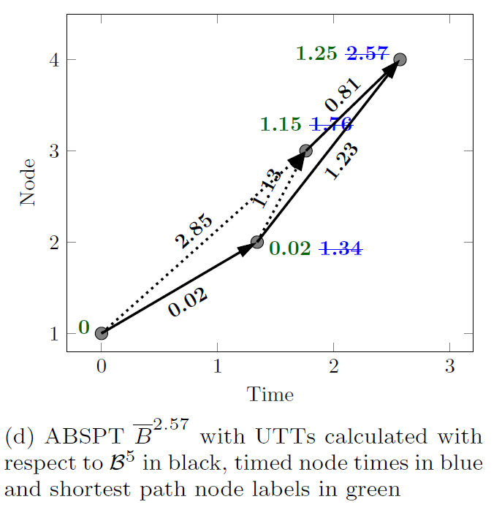
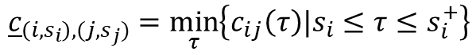
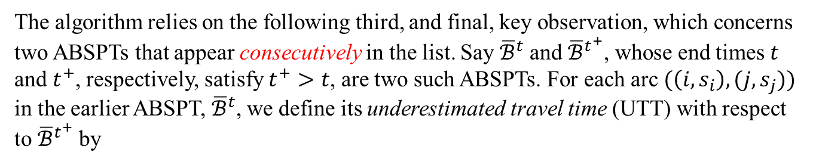
MDP
The DDD algorithm for MDP
Consider the derivation of the lower bound on the minimum duration:
The algorithm relies on the following third, and final, key observation, which concerns two ABSPTs that appear consecutively in the list. Say ${\overline{ℬ}}^{t}$ and ${\overline{ℬ}}^{t^{+}}$, whose end times $t$ and $t^{+}$, respectively, satisfy $t^{+}>t$, are two such ABSPTs. For each arc $(\left(i,s_{i}\right),(j,s_{j}))$ in the earlier ABSPT, ${\overline{ℬ}}^{t}$, we define its underestimated travel time (UTT) with respect to ${\overline{ℬ}}^{t^{+}}$ by
$${\underline{c}}_{\left(i,s_{i}\right),(j,s_{j})}=\min_{τ}\left\{c_{ij}\left(τ\right)|s_{i}≤τ≤s_{i}^{+}\right\}$$
where $\left(i,s_{i}^{+}\right)$ is the timed node for $i$ in the later ABSPT.

Slide 19
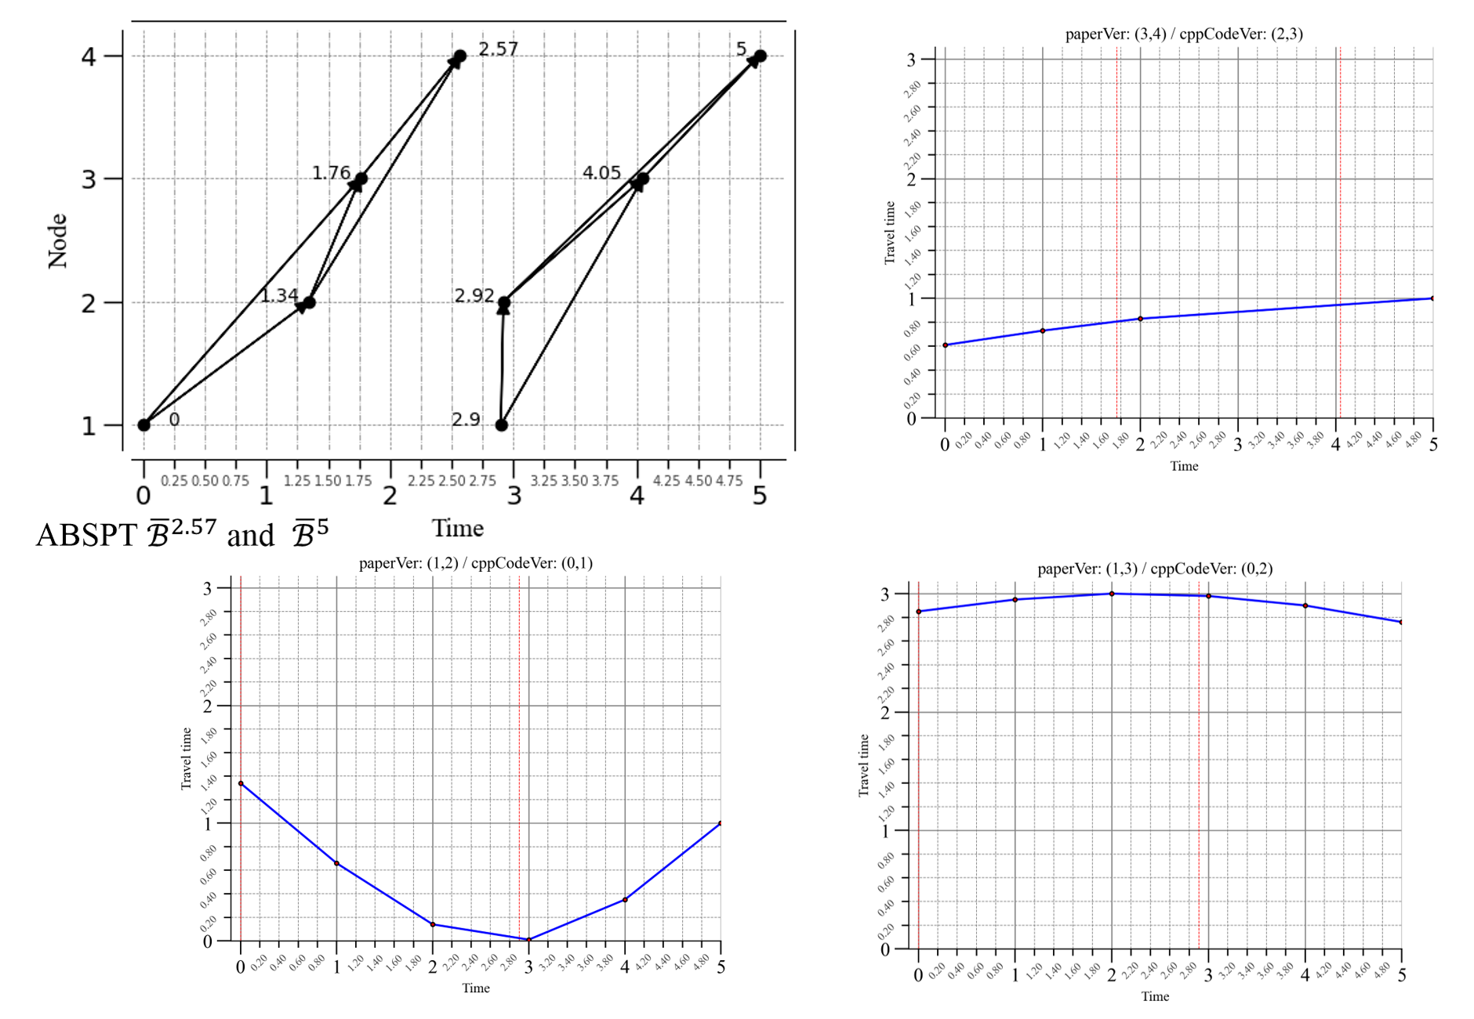
MDP
The DDD algorithm for MDP
0.81
0.02
2.85

Slide 20
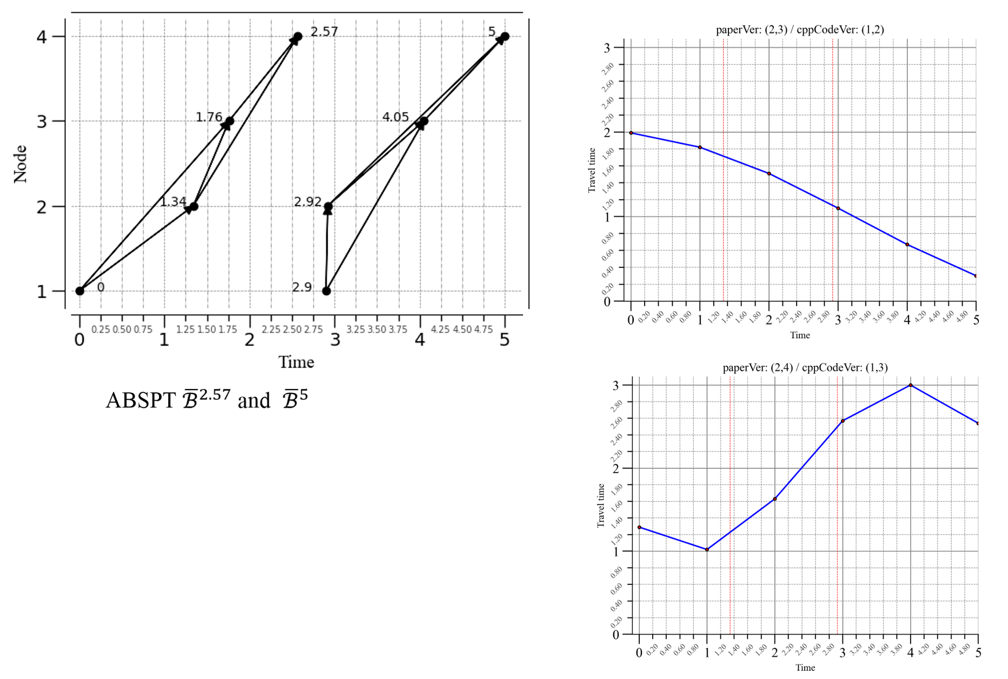
MDP
The DDD algorithm for MDP
1.13
1.23

Slide 21
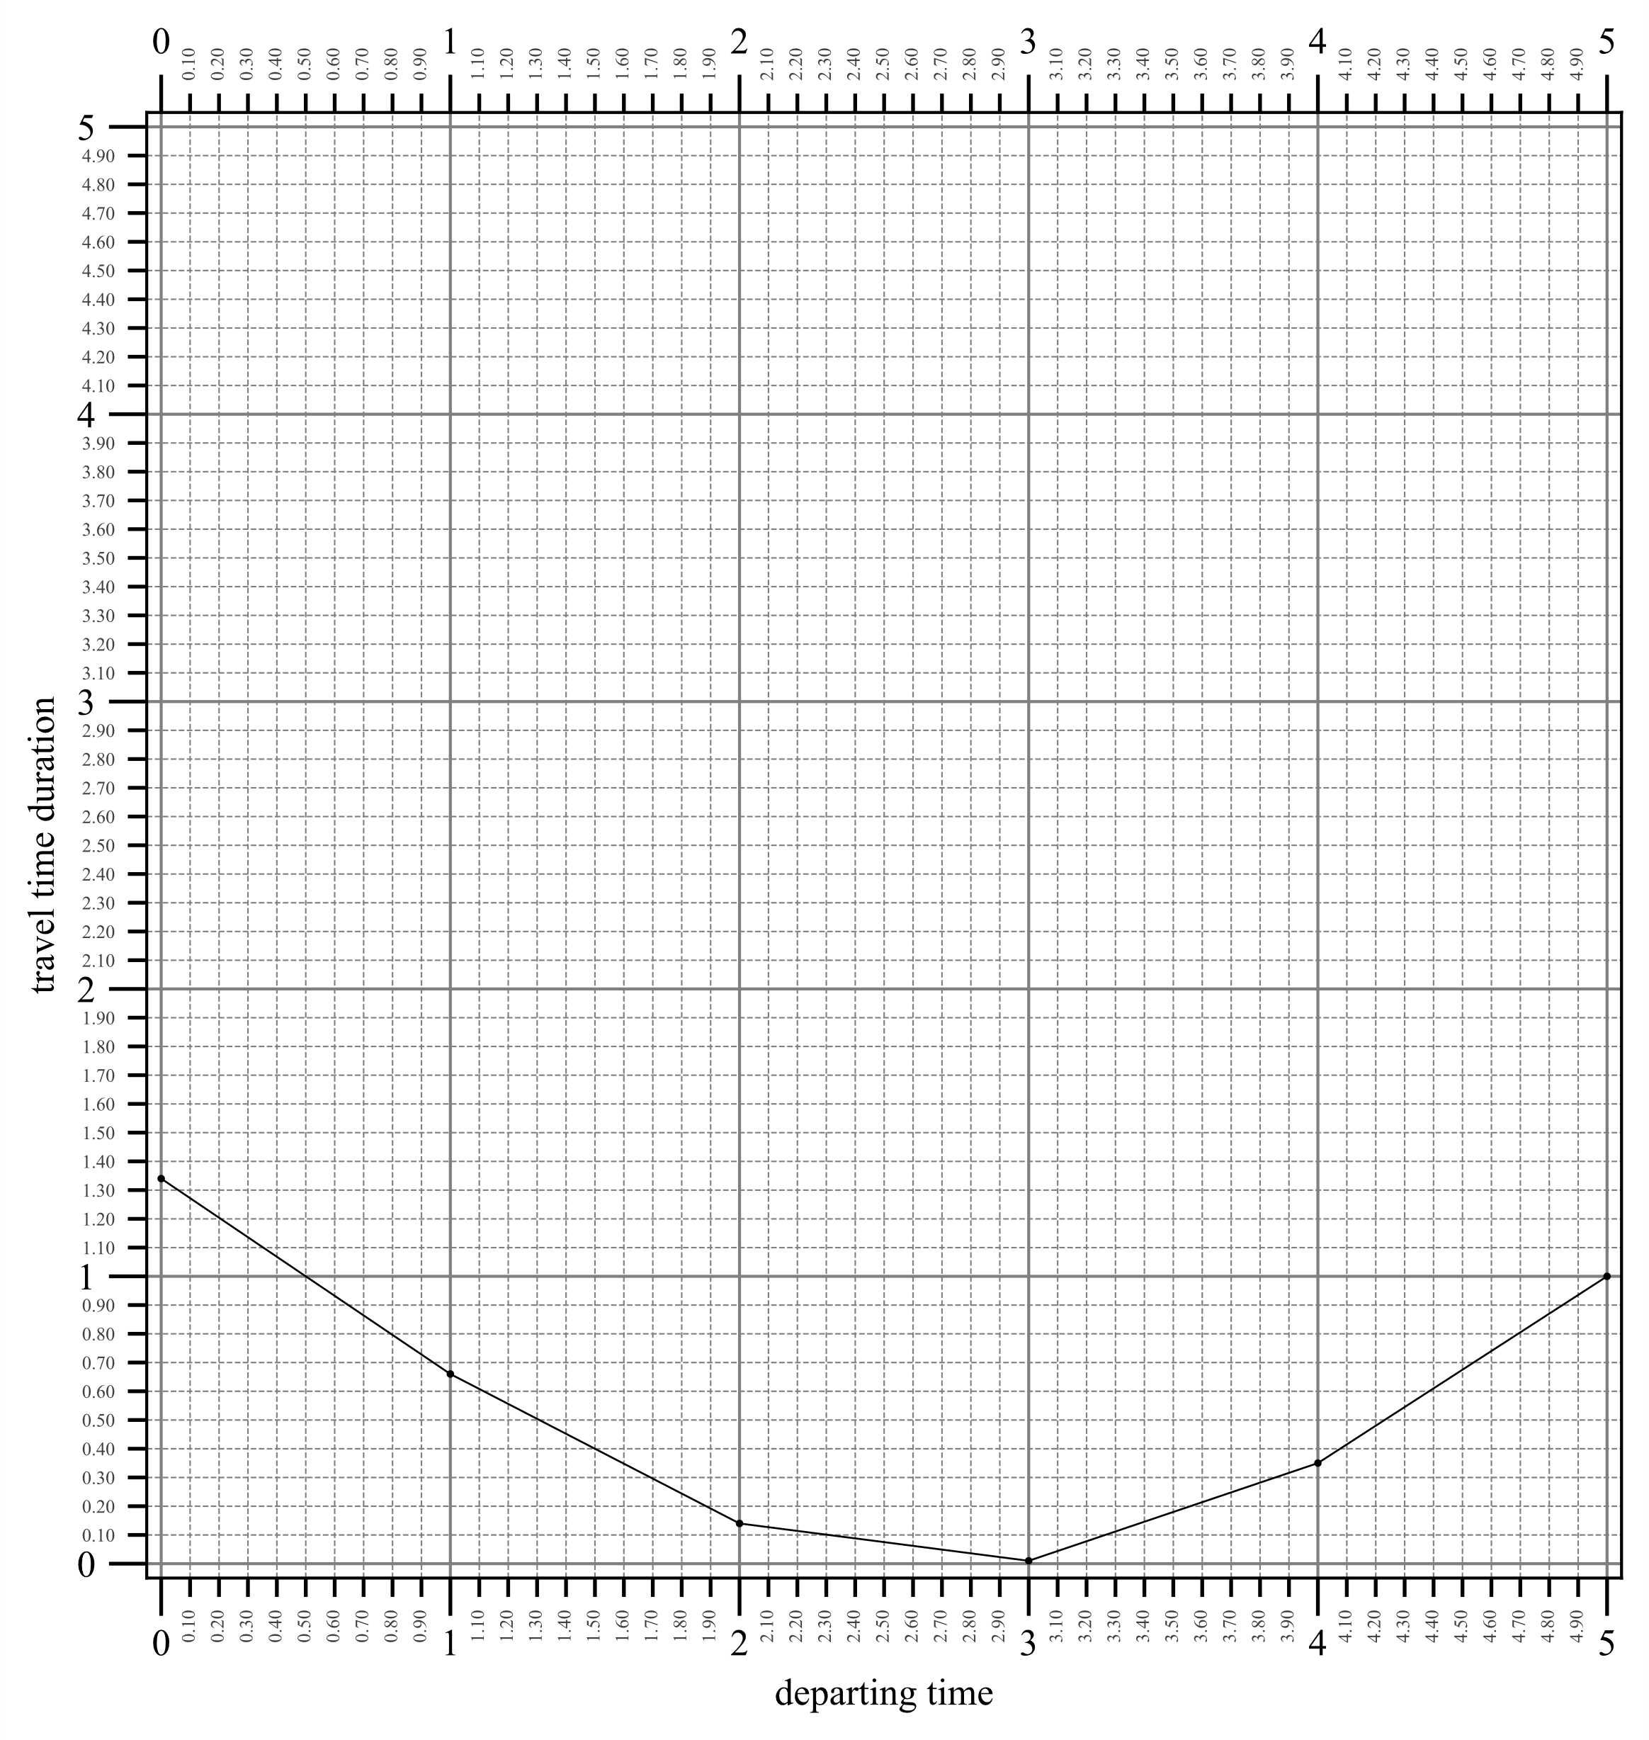
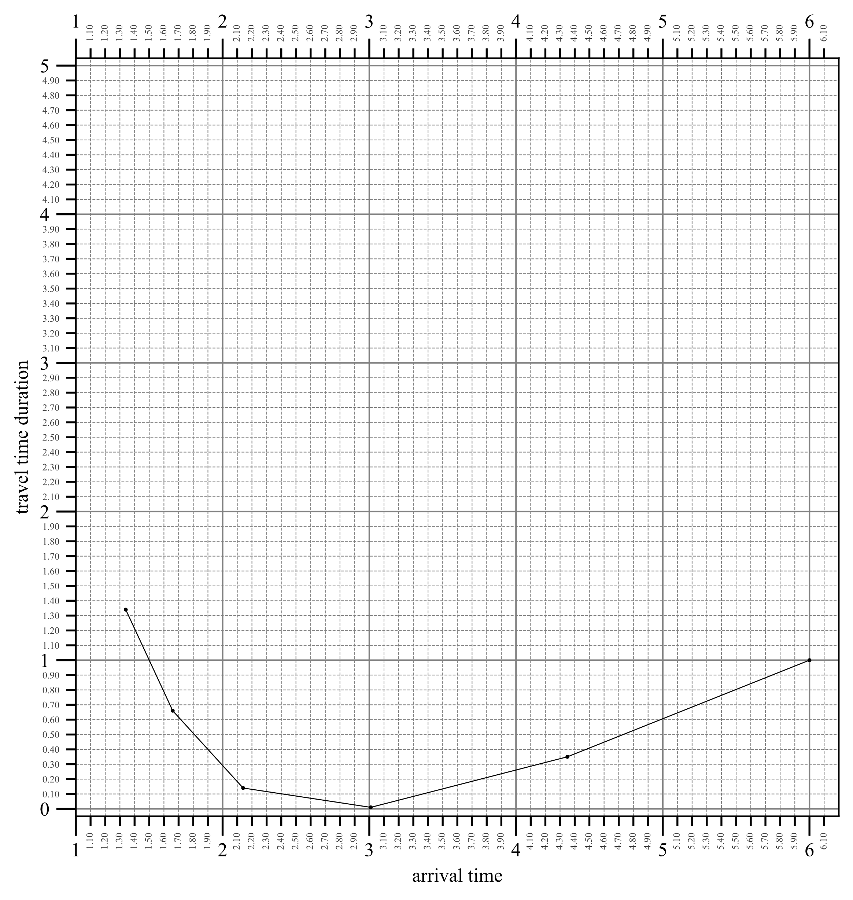
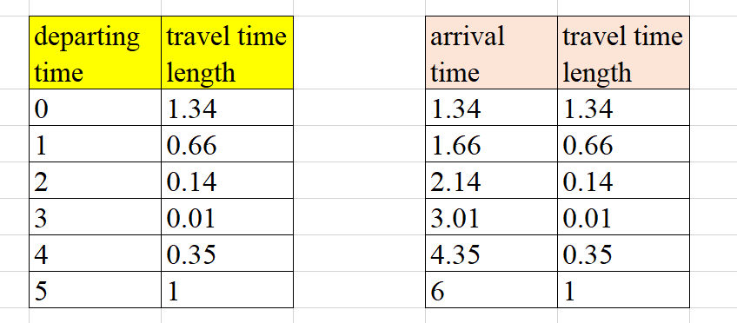
MDP
The DDD algorithm for MDP

Slide 22
MDP
The DDD algorithm for MDP

Slide 23
MDP
The DDD algorithm for MDP
Consider the derivation of the lower bound on the minimum duration...
The least UTT path in each ABSPT in the list provides a lower bound on the duration of any feasible timed path arriving in the subinterval between its arrival time at the end node, and that of the next ABSPT in the list.
Discussion about the global lower bound:
Question is: how to increase the lower bound?

Slide 24
MDP
The DDD algorithm for MDP
Let us find out the ways to improve the lower bound...
In fact, improving the lower bound is closely related with dynamically generating new ABSPTs.
Therefore, we need to consider how to discover and generate such new ABSPT.
All the magic comes from the breakpoints of the arc travel time function. For more, please refer to this paper:
Foschini, L., Hershberger, J., & Suri, S. (2011, January). On the complexity of time-dependent shortest paths. In Proceedings of the twenty-second annual ACM-SIAM symposium on Discrete algorithms (pp. 327-341). Society for Industrial and Applied Mathematics.
Notes:
Dean

Slide 25
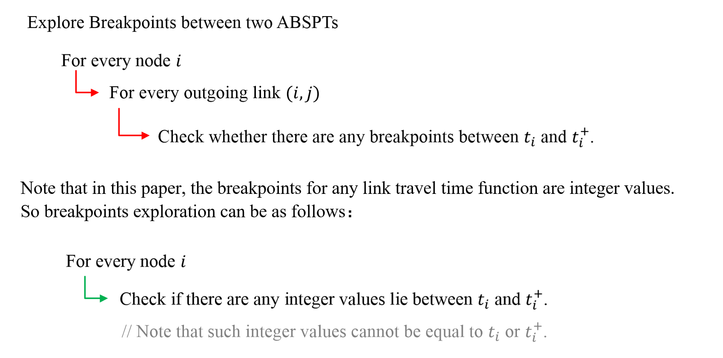
MDP
The DDD algorithm for MDP

Slide 26
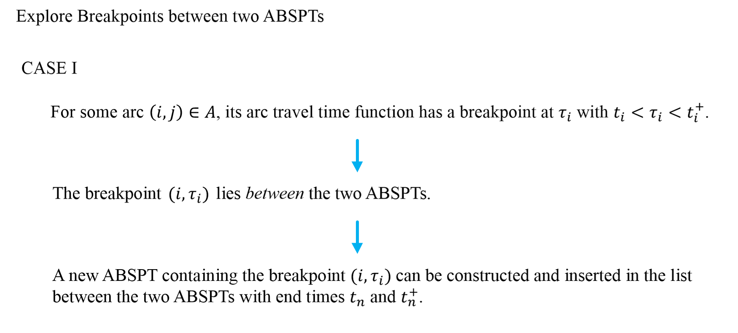
MDP
The DDD algorithm for MDP

Slide 27
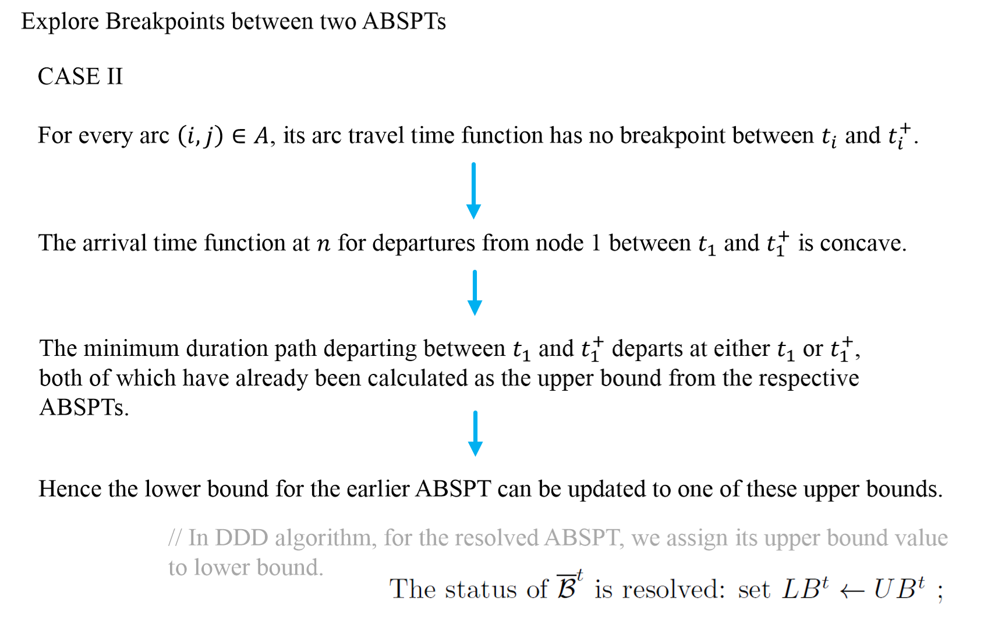
MDP
The DDD algorithm for MDP

Slide 28
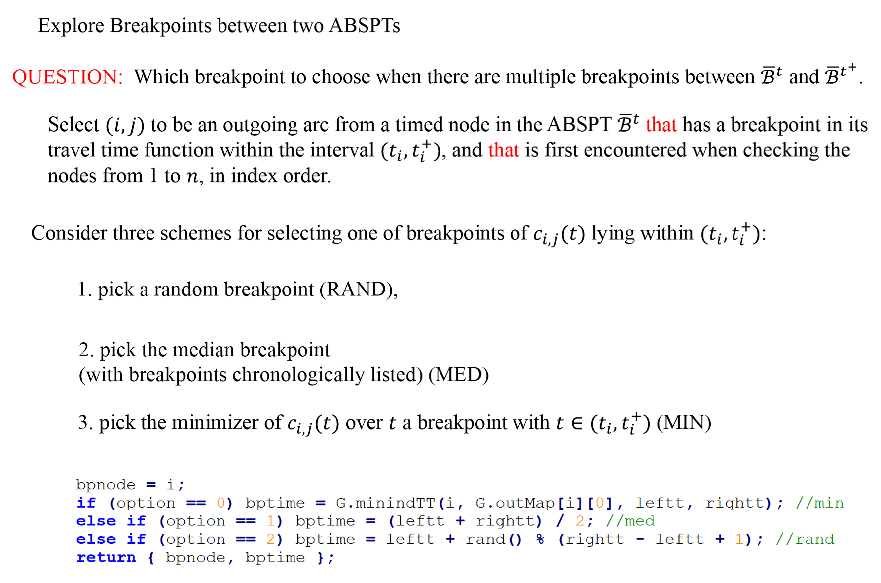
MDP
The DDD algorithm for MDP

Slide 29
THANK YOU

